Slide 1
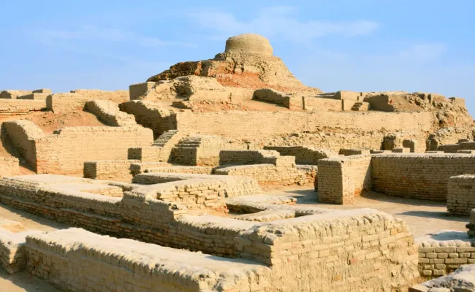
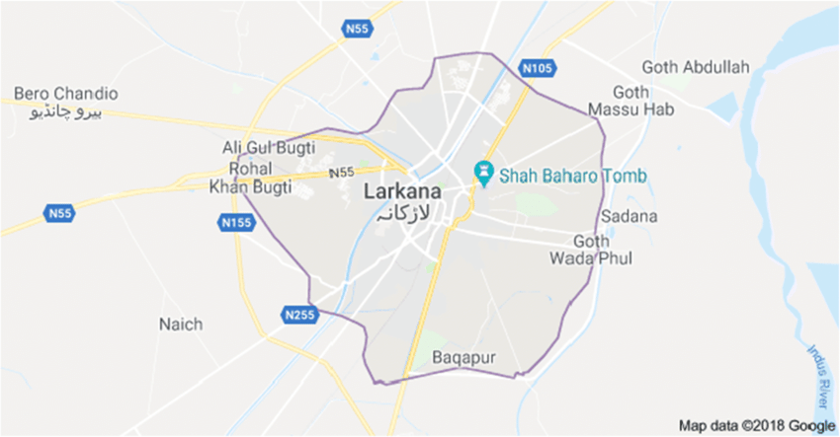
Larkana, Sindh
Presented by: Saqib & Alisha

Slide 2
Outlines
Introduction
History of Larkana
Administration
Economy
Education
Demographics
Districts
Famous Personalities
Conclusion

Slide 3
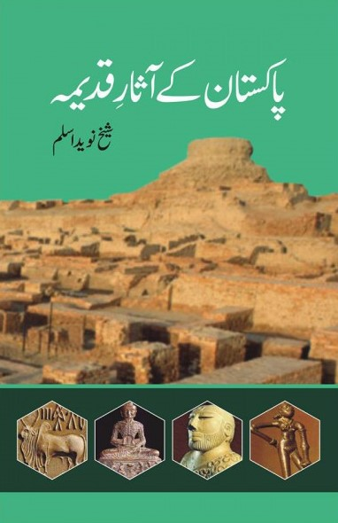
History of Larkana
Larkana is one of the oldest city which had once a great civilization called Mohan-jo-Daro.
Sheik Naveed Aslam has written in his book, Pakistan k Aasar-e-Qadeem, on pg.no: 60:
“About 4.5 hundred years ago, on this land, there was a great civilization of Mohan-jo-Daro, which is considered as one of the oldest civilization of Sub-continent.”

Slide 4
History…
Larkana was first set as a district by British government in 1901, since then there have been many changes to it. In 1931, Larkana was splits and new district formed called Dadu. In 1980, Larkana was given status of division but in Mushraff’s era in 2000 the status was abolished but again in 2011 the division status was released, and now it comprises the following districts:
Jacobabad District
Kashmore District
Larkana District
Qambar-Shahdadkot District
Shikarpur District

Slide 5
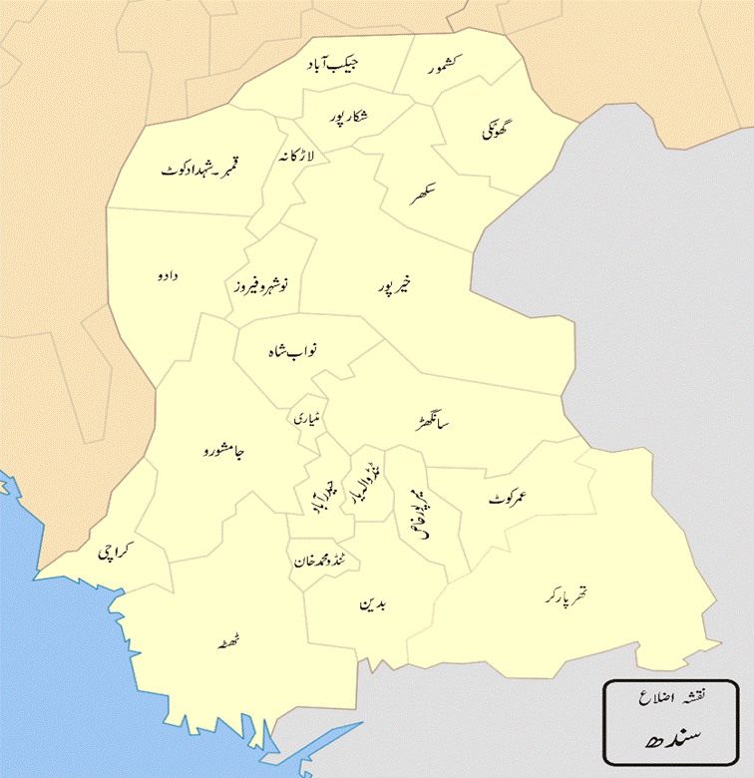
Administration
The district of Larkana is administratively subdivided into the following tehsil:
Dokri Tehsil (Labdarya Tehsil)
Bakrani Tehsil
Larkana Tehsil
Ratodero Tehsil
Naudero Tehsil

Slide 6
Sheikh Mujeeb’s Six Points
Districts
Qamber-Shahdadkot
Kashmore
Jacobabad
Shikarpur

Slide 7
Economy
Around 10 km away from Larkana City, sugarcane is cultivated and processed at the Larkana Sugar Mills (Pvt) Ltd. plant, which was inaugurated by former Prime Minister Zulfikar Ali Bhutto on 30 January 1974.
Larkana's guava and berries are famous both nationally and internationally, with the annual output of the district standing at thousands of tons. All the villages of Larkana District on the right bank of the Indus River have vast guava orchids spread over thousands of acres, located in Dodai, Mahotta, Naudero, Chooharpur, Agani, Metla, Izzat Ji Wandh, Phulpota and other villages.

Slide 8
Education
The Government Pilot School was built in 1926, being the oldest education institution in the district. Cadet College Larkana was inaugurated by the former Prime Minister of Pakistan Benazir Bhutto in 1994, first planned by her late father Prime Minister Zulfikar Ali Bhutto in 1975. The College is located 24 kilometres (15 mi) away from Larkana, and some 3 kilometres from Mohenjo-daro.
According to 2017 census, literacy rate of Larkana is 53.80%. Sindhi is well understood and commonly spoken by the majority of the population.

Slide 9
Demographics
According to the 2017 census, the literacy rate of Larkana was 53.80% and overall population was 6.192 million.
Sindhi is well understood and commonly spoken by the majority of the population.
The majority religion is Islam, with 98.45% of population registering Muslims and rest is minority among which Hindus are 1.45% of the population.
Sindhi was the predominant language spoken by 97.25% of the population.

Slide 10
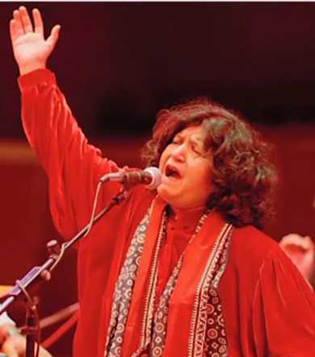
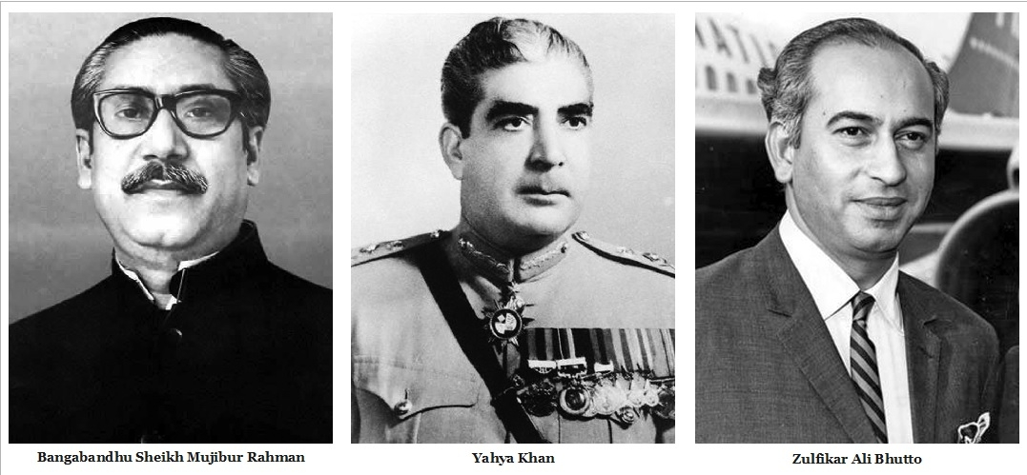
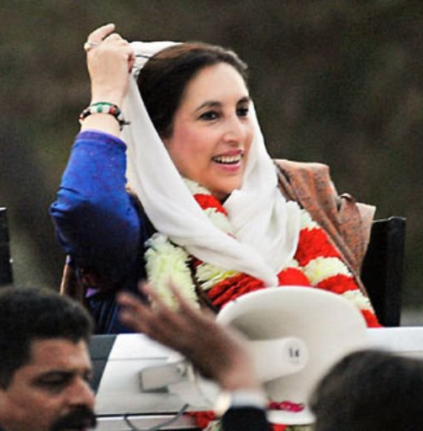
Famous Personalities:
Zulfikar Ali Bhutto and Benazir Bhutto, political stalwarts born in Larkana, have left an enduring legacy in the annals of Pakistani history. Abida Parveen, the celebrated Sufi singer, adds a musical note to the city's fame. Larkana continues to nurture and produce influential figures in politics, music, and literature.

Slide 11
Conclusion:
In conclusion, Larkana's journey from ancient history to contemporary significance is a tale of resilience, culture, and economic prowess. The city continues to evolve, and the proactive role of the Sindh government ensures a promising future for Larkana and its residents.

